Slide 1
Comparative Analysis Of Actively Managed Funds vs Benchmark Index Performance
Presented By
Saloni Dedhia

Slide 2
Introduction
Active Fund - Fidelity Contrafund
Passive Fund - Vanguard
Investment funds where portfolio managers actively make decisions on buying/selling securities to outperform a benchmark index
Features:
Higher Fees
Potential for Outperformance
Higher Risk
Passive funds designed to replicate the performance of a specific market index
Features:
Lower Fees
Consistent Returns
Lower Risk

Slide 3
Comparison Framework
Metrics for Comparison
To evaluate and compare the performance and risks of actively managed funds vs. benchmark index funds, we will use the following key metrics:
Annualized Returns
Expense Ratios
Volatility (Standard Deviation)
Sharpe Ratio
Sector Allocation
Historical Performance Over Time

Slide 4
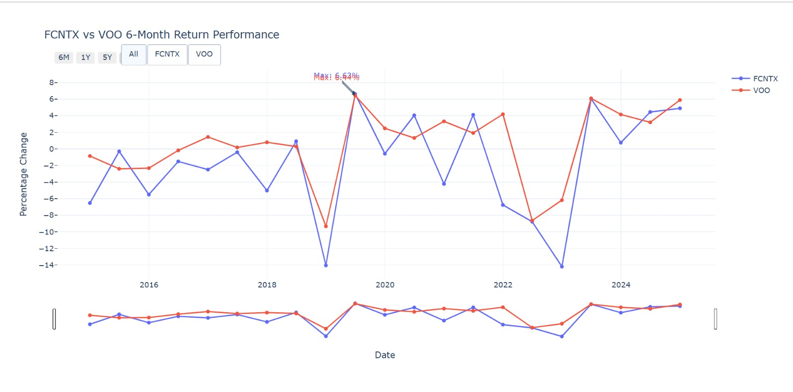

Slide 5
Overview of Vanguard (VOO)
It is passive strategy fund
Minimum investment $1 require
No lock in period
Objective is to replicate benchmark return

Slide 6
Overview of Fidelity Contrafund (FCNTX)
It is active strategy fund
No minimum investment require
No lock in period
Objective is to beat benchmark return

Slide 7
Sources of Active Return
Dividing portfolio across various assets
It accounts for 90% of total portfolio return
Choosing individual securities within sectors
Asset Allocation :
Security Selection :

Slide 8
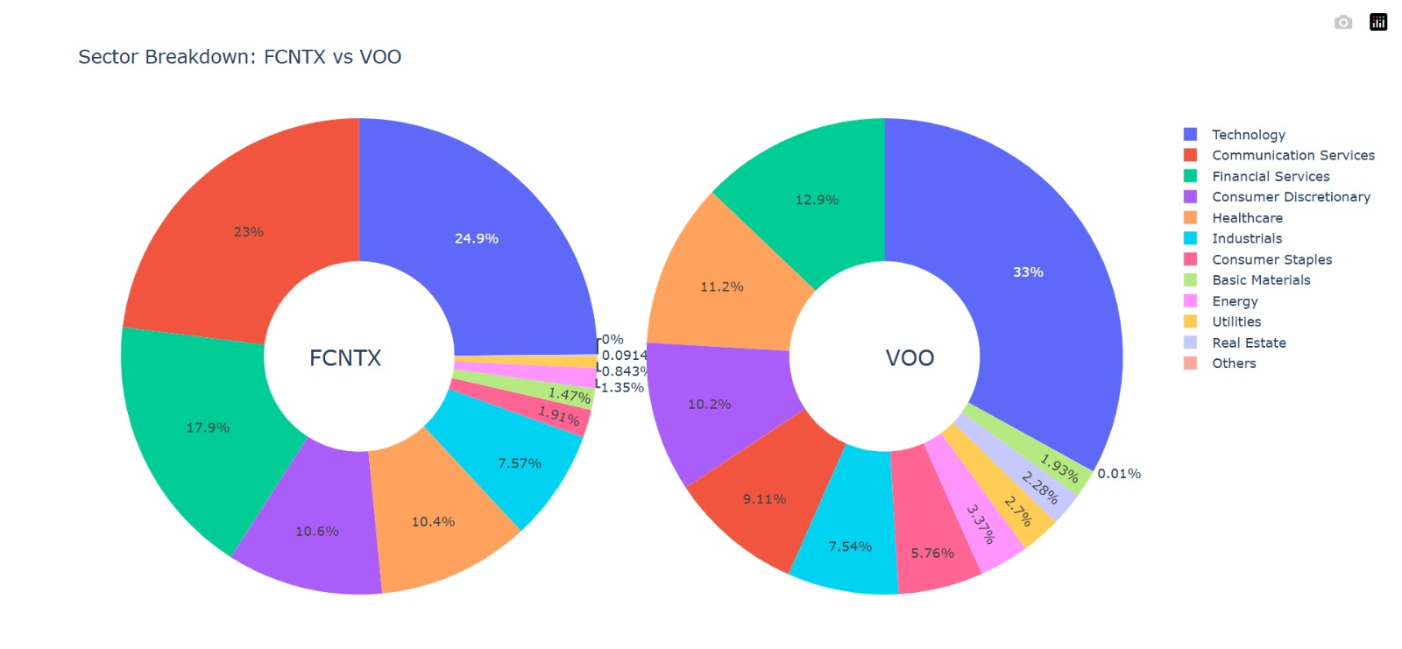
Asset Allocation

Slide 9
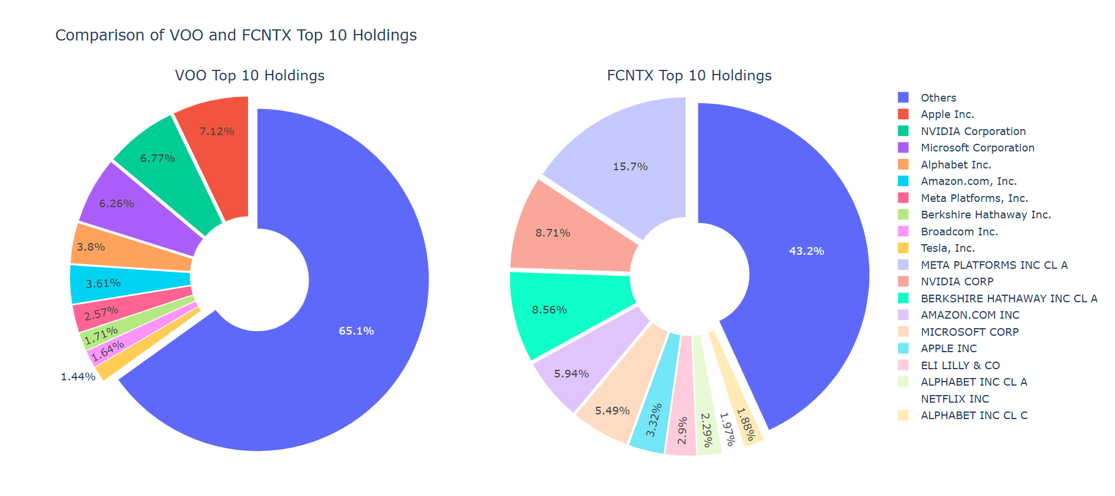
Security Selection
VOO
FCNTX

Slide 10
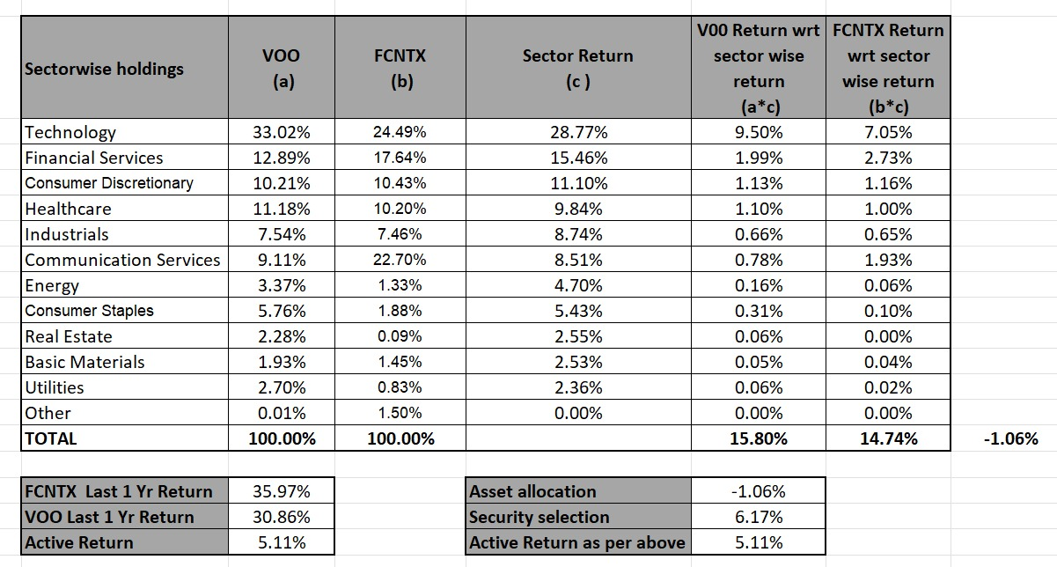

Slide 11
Factors to be Considered Before Selecting Fund?
Investor Objective
Risk Appetite
Expense Ratio
Transaction Cost
Time Horizon
Manager Expertise

Slide 12
Do Passive Strategies Always Mimic the Performance of Benchmark?
No, Due to Tracking Error
Reason for Tracking Error:
Transaction cost
Management fee
Rebalancing delay

Slide 13
Risk-Adjusted Performance Metrics
Metric | Purpose | Value
Sharpe Ratio | For Passive Funds | 1.51%
Information Ratio | For Active Funds | 3.60%

Slide 14
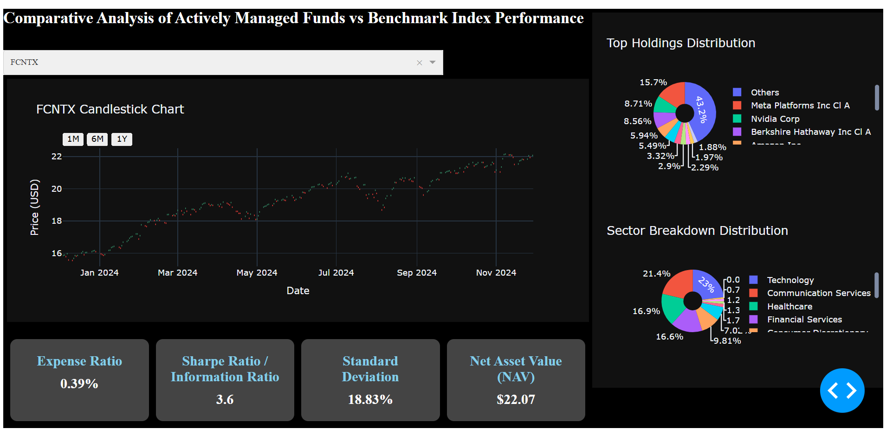
Click Here

Slide 15
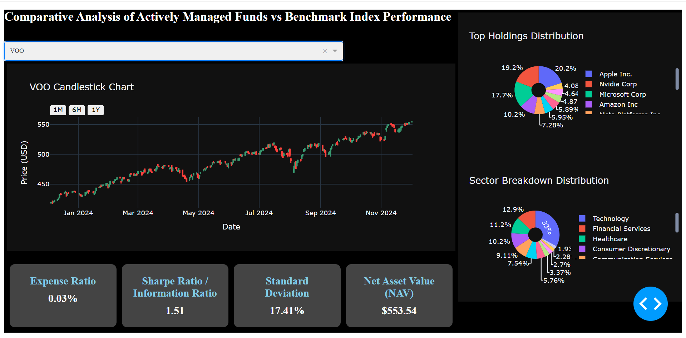

Slide 16
Methodology
Libraries used:
Pandas, Yfinance, Plotly, Matplotlib, Webbrowser, Threading, Dash
Ticker Analysis
Line and Pie Chart
Sector-Wise Returns Analysis
Dashboard Creation

Slide 17
Conclusion
At 1 year, fidelity fund beating the benchmark and generating 5.11% of active return
At 10 year, active fund is not beating the benchmark
Active manager is bad at asset allocation but good at security selections
Net profit after expense ratio
Vanguard: 30.83%
Fidelity: 35.58%
Risk factor: IR is higher than SR which shows, active manager is better than passive manager

